Slide 2
“Making Comparisons”
Manuel Saldaña Franquis

Slide 3
“Making Comparisons”
Resumen
Al comparar dos elementos tales como personas, cosas, lugares, etc., es necesario utilizar la forma comparativa del adjetivo, la cual se basa en un conjunto de reglas.
Abstract
When comparing two elements such as people, things, places, etc., it is necessary to use the comparative form of the adjective which is based on a group or rules.

Slide 4
“Making Comparisons”
Key words: adjective, than, more, irregular, one-syllable.

Slide 5
HOW TO MAKE THE COMPARATIVE FORM OF ADJECTIVES
 | Adjective | Comparative
One-syllable adjectives | cheap large big | cheaper than larger than bigger than
-e adjectives | nice late | nicer than later than
-y adjectives | noisy sunny | noisier than sunnier than
Adjectives with Two or more syllables | expensive comfortable intelligent | more expensive than more comfortable than more intelligent than
Irregular adjectives | good bad far | better than worse than farther than
Add -er
Add -r
Change “y” to “i” + er
We use “more” + adjective

Slide 6
COMPARING STATES OF THE MEXICAN REPUBLIC

Slide 7
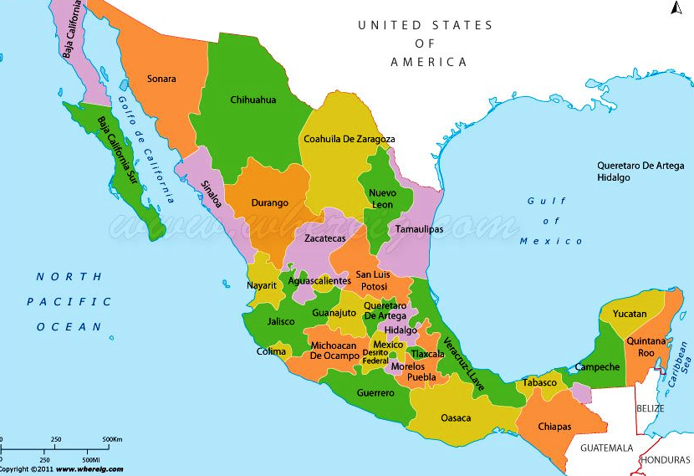

Slide 8
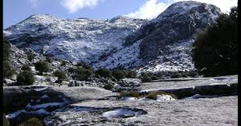
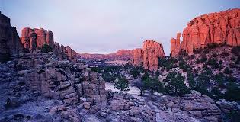
Durango is cold in winter.
Zacatecas is cold too.
Durango is colder than Zacatecas.

Slide 9
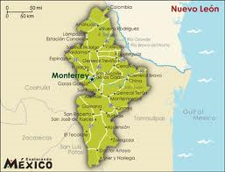
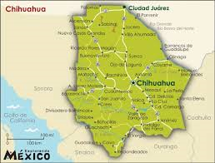
Nuevo Leon is big too.
Chihuahua is a big state.
Chihuahua is bigger than Nuevo Leon.

Slide 10
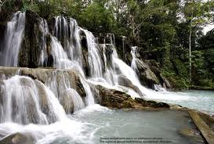
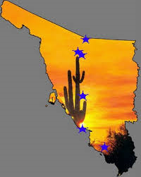
Tabasco’s weather is hot too.
Sonora’s weather is hot.
Sonora is hotter than Tabasco.

Slide 11
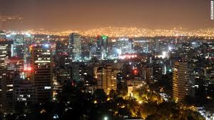
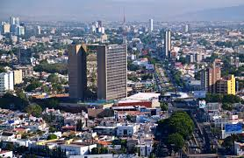
Mexico City is noisy too.
Guadalajara is a noisy city.
Mexico City is noisier than Guadalaja.

Slide 12
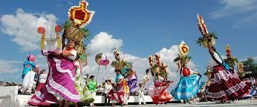
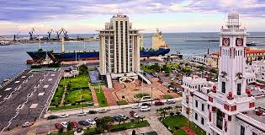
Oaxaca is a tourist city too.
Veracruz is a tourist city.
Oaxaca is more tourist than Veracruz.

Slide 13
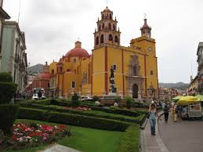
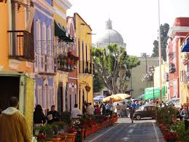
Puebla is traditional too.
Guanajuato is traditional.
Puebla is more traditional than Guanajuato.

Slide 14
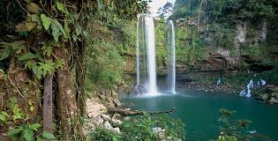
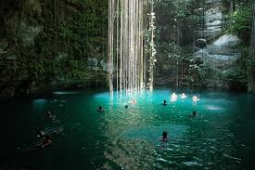
Chiapas is good too.
Yucatan is a good place.
Yucatan is better than Chiapas.

Slide 15
Bibliografía
Referencias
- Evans V. & Dooley J. (1998). Enterprise 1 Coursebook Beginner. Express Publishing.

