Slide 2
Password (VOCABULARY ABOUT JOBS AND PROFESSIONS)
An interactive game called “Password” that can be used as a vocabulary review activity in which students can practice any kind of vocabulary. This time the topic is about jobs and professions.

Slide 3
La siguiente presentación es un juego interactivo llamado “Password” que puede ser utilizado como actividad de repaso de vocabulario, en el cual los alumnos pueden practicar cualquier tipo de vocabulario. En este caso, el tema es acerca de oficios y profesiones.

Slide 4
A Vocabulary Review Activity

Slide 5
Setup Directions:
Type a vocabulary word on each of the following 10 slides in the subtitle textbox. When complete, run the show by pressing F5 on the keyboard.
One student stands with back to this presentation.
The class gives the student clues to the vocabulary word onscreen as a clock keeps time.
The student tries to guess the word before the buzzer.

Slide 6
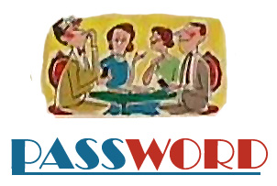
Ready to play?

Slide 7
The
is…
mechanic

Slide 8
The
is…
bus driver

Slide 9
The
is…
secretary

Slide 10
The
is…
architect

Slide 11
The
is…
doctor

Slide 12
The
is…
firefighter

Slide 13
The
is…
hairdresser

Slide 14
The
is…
nurse

Slide 15
The
is…
farmer

Slide 16
The
is…
lawyer

Slide 17
The
is…
teacher

Slide 18
Taken from an adaptation of Connie Campbell.

Slide 19
LELI. Karla Estela Capetillo Cerón

