Slide 1
Academia:
Idiomas
Inglés VI Unidad 2
Tema: 2.1. Enfatizar hechos
2.1.1 Enfatizar hechos en presente (Contraste entre la voz pasiva y la voz activa 1)
Profesora:
Lic. Katya Gabriela Ortega Mendoza
Periodo: Enero – Junio 2016

Slide 2

Resumen (abstract)
When the action itself is more important than the person who carries it out; we have the possibility to use the passive voice. It could be use in any verb tense as needed.
Tema: Enfatizar hechos
Palabras clave (keywords): action, passive voice, verb tense.

Slide 3
Passive voice
Present tense

Slide 4
Somebody cleans the office everyday.
Active Voice
The office is cleaned everyday.
Passive Voice

Slide 5
Now, take a look in this information…
Active
Miguel de Cervantes wrote “The Quixote”
Passive
“The Quixote” was written by Miguel de Cervantes

Slide 6
The passive is:
Verb to Be
(am / is / are /
was / were)
Past Participle
(Cleaned / Built
/written)

Slide 7
The passive is used:
When the person who carries out the action is unknown, unimportant or obvious from the context.
  The machine was damaged (We don’t know who damaged it)
When the action itself is more important than the person who carries it out.
  A man was attacked last night.
If we want to say who does or what causes the action, we use by
  A cake was baked by Sarah.
We use with to say what the agent used.
  The cake was made with eggs, flour and sugar.
The passive is used more often in written English than in spoken English.

Slide 8
Now, check these examples…
How to use the passive voice in a real text?

Slide 9
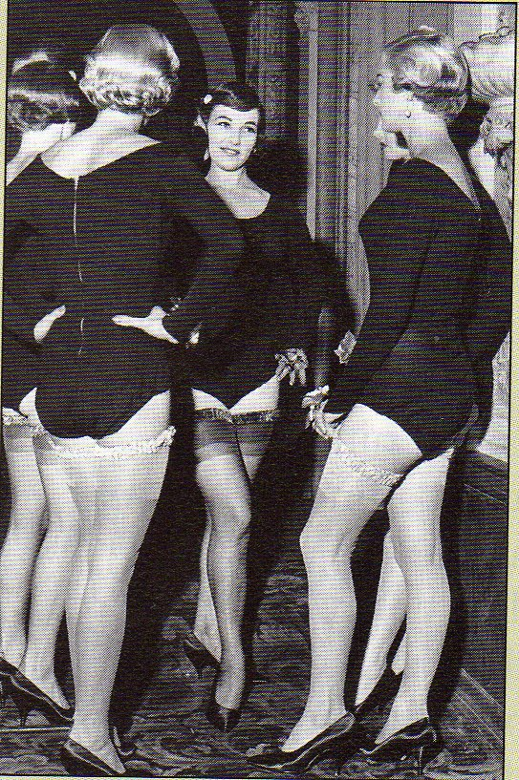
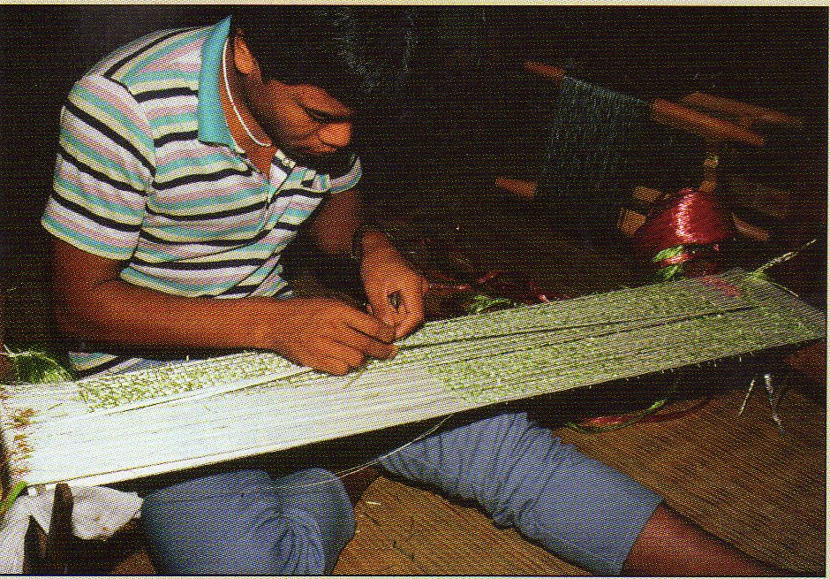
Did you know?
Nylon was invented in 1935 by American chemist Wallace Carothers. Nylon stockings appeared in the U.S. around 1940.
Silk was discovered in China about 5,000 years ago. The fabric became so treasured that it was used as a form of money.

Slide 10
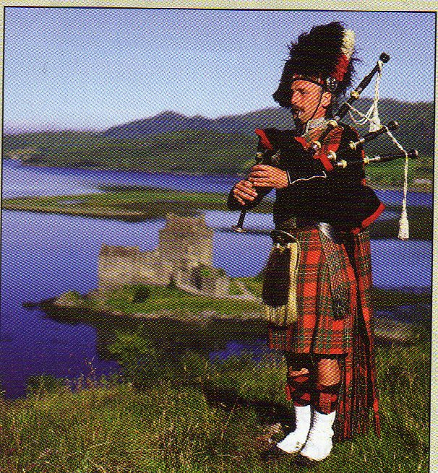
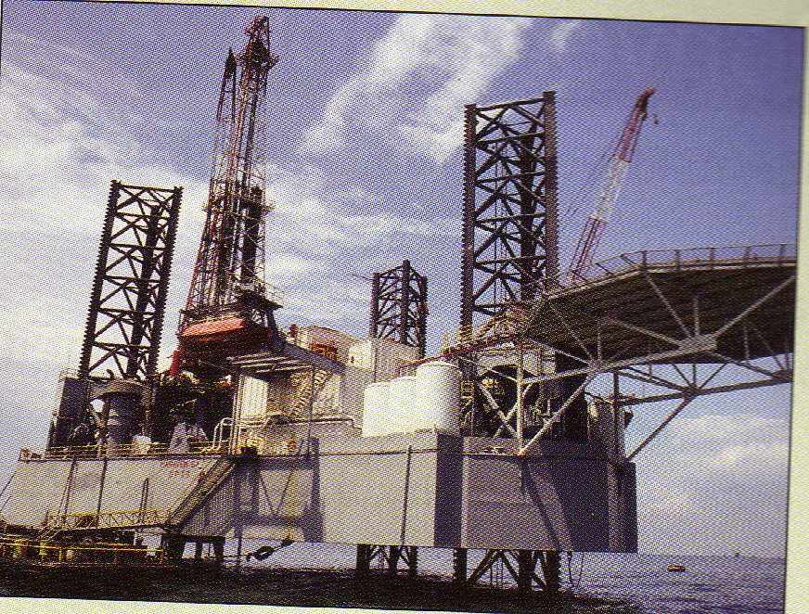
Did you know?
Kits are worn in Scotland. The kit is the traditional dress for men in that country. It is a kind of skirt. Kits are made of wool, and each tartan pattern represents a different Scottish clan, or family group.
Venezuela is one of the world’s biggest oil producers. Millions of barrels of oil are exported per year. Maracaibo is the main oil – producing area

Slide 11

In the last examples…
We can see that PASSIVE VOICE is used to create definitions of different objects, including information about their origins, materials and historic facts

Slide 12
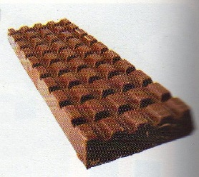
Let’s talk about chocolate! Choose the correct words.
In the 16th century the Spanish explorer Hernan Cortés (1)travelled / was travelled to South America. There he met the Aztecs and he (2)was served / served a drink called “xocoalt” by them. Xocoalt (3)was made / made from cocoa beans which (4)grow / are grown on cocoa trees. Cortés (5)took / was taken some beans to Spain, where sugar (6)was added / added. The first chocolate bars (7)produced / were produced many years later. Today everyone (8)loves / is loved chocolate. It (9)is eaten / eats by millions of people all over the world.

Slide 13
Check your answers…
In the 16th century the Spanish explorer Hernan Cortés (1)travelled / was travelled to South America. There he met the Aztecs and he (2)was served / served a drink called “xocoalt” by them. Xocoalt (3)was made / made from cocoa beans which (4)grow / are grown on cocoa trees. Cortés (5)took / was taken some beans to Spain, where sugar (6)was added / added. The first chocolate bars (7)produced / were produced many years later. Today everyone (8)loves / is loved chocolate. It (9)is eaten / eats by millions of people all over the world.

Slide 14
Referencia bibliográfica, infográficas y/o cibergráficas
Mitchel, H. Q. (2006). Top grammar elementary 2. UK: MM publications.

