Slide 1

ÁREA ACADÉMICA: INGLÉS II
TEMA: POLLUTION
PROFESOR: MTE. HEIDI ZAMORA NAVA
PERIODO: ENERO – JUNIO, 2017
TEACHER:
MTE. HEIDI ZAMORA NAVA
SEMESTER:
January – May, 2015

Slide 2
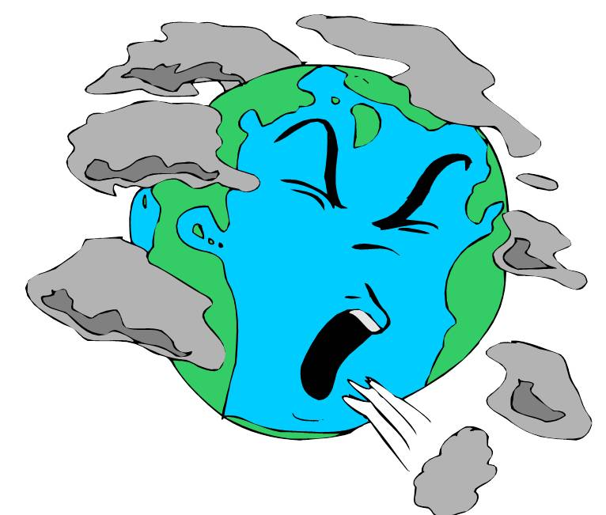
UNIT 1.
WHAT’S HAPPENING?
Are you ill??? jajajaja
VOCABULARY ABOUT ECOLOGY, BIOLOGY AND POLLUTION.

Slide 3
ABSTRACT:
In this class, we discuss about the problems our planet is facing with all the wastes people are producing every day.
Key words: pollution, wastes, fume, chemicals, substances.

Slide 4
OBJECTIVE:
At the end of the class, students will be able to describe ecological problems affecting their environment.

Slide 5
COMPETENCES
# 4. Student expresses him/herself and communicates.
“He/she listens, interprets and communicates relevant messages to different contexts by using appropriate means, codes and/or tools”
Atribute:
#4. He/she communicates in a second language in every day situations.

Slide 6
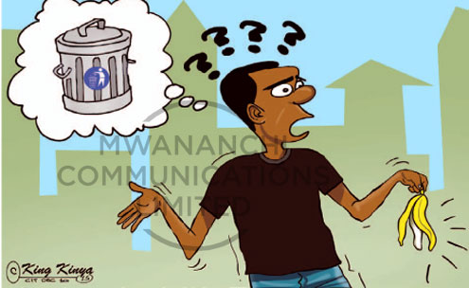
Hey!!!!! Are you a green citizen???
A green what???!!!

Slide 7
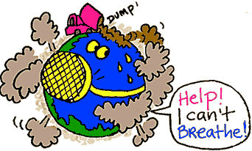

Yeahhhh!! Every day many people are contaminating me and in the future I will disappear!!!
Pleaseeeeee, help me to take care of me!!!! I’m dying!!

Slide 8
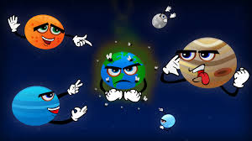
Remember!!! I am the unique planet to live in!!!!!

Slide 9
We need to attack the main pollution problems…
First of all, you need to know what pollution is.
It is when substances are put into the environment that destroy living organisms

Slide 10

And how is it divided?
What world do you want to live in?

Slide 11
Water pollution
Industries are dropping a lot of wastes in our lakes, lagoons and rivers.
Our potable water is ending.
What will you drink??

Slide 12
Soil pollution
Farmers are using pesticides for growing vegetables and fruits.
Many food are provoking a lot of sicknesses!!

Slide 13
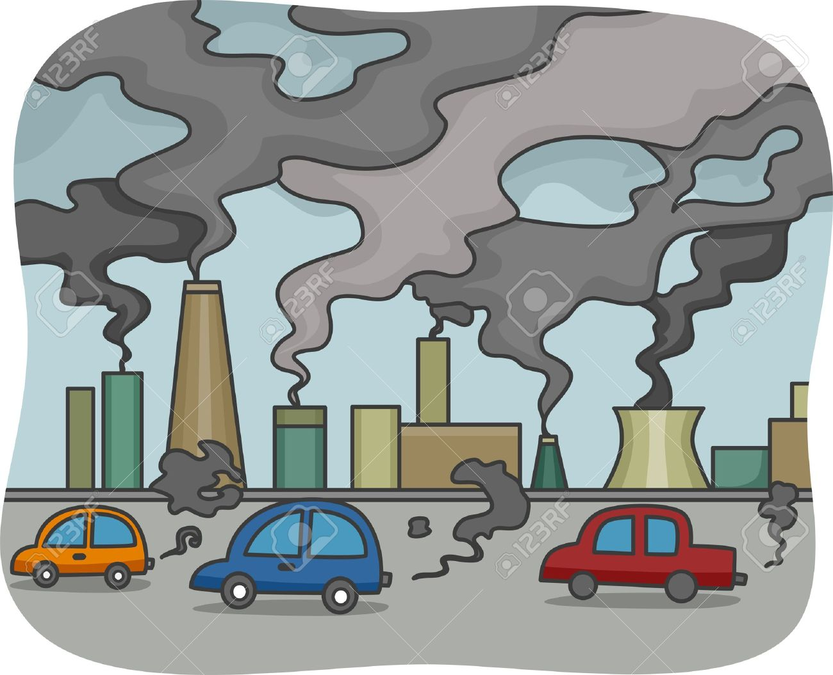
Air pollution
The use of cars are producing a lot gases.
The factories are emitting too much fume and the smog is concentrating in our atmosphere.

Slide 14
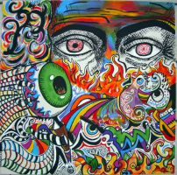
Visual pollution
Youngsters are painting our walls with bad graffitties because they use too many colors.
Even, some companies are placing a lot of bright signs on highways and these are provoking many car crashes every day.

Slide 15
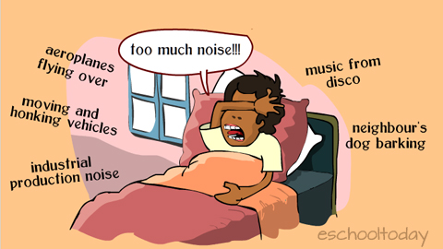
Noise pollution
Most humans are suffering noise pollution and their hearing is decreasing.
Many people are getting on their nerves with all the noise in their daily life.

Slide 16
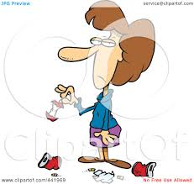
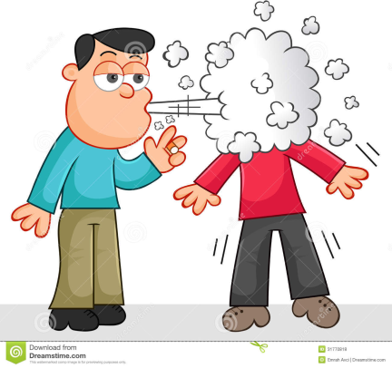
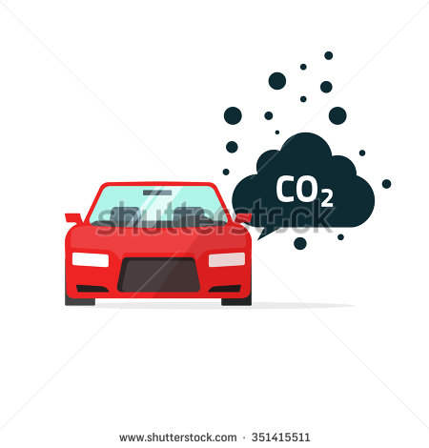
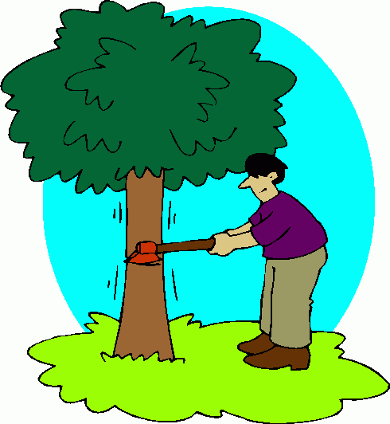


And you, what are you doing?

Slide 17
Bibliografía básica:
Davies, P. (2013). Make It Real!. A1.2 México: Imprenta UAEH
KET Vocabulary List (2009). University of Cambridge ESOL Examinations. Consulta realizada en: http://www.cambridgeesol.org/assets/pdf/exams/ket/ket-vocab-list.pdf 109781_ket_schools_handbook.pdf
Imágenes:
https://clipartfox.com/categories/view/9bd22d8bafe11ff0aa8aaf194c3e381722e39d72/clipart-pollution-cartoon.html
https://www.clipartsgram.com/air-pollution-cartoon-clipart-13250
https://clipartfest.com/categories/view/220cc3b2d7d8cd1861b433545e42ac0afd09e109/air-pollution-clipart.html
https://www.shutterstock.com/search/water+pollution
https://clipartfest.com/categories/view/a6c41d87cde12676bc864b8ca37bccfdefd2a791/soil-pollution-clipart.html
https://www.toonpool.com/cartoons/Land%20of%20fire_220446
https://clipartfest.com/categories/view/0f8b626f90dfcece2e116d5384a59f0c9ab33d09/air-pollution-cartoon-clipart.html
https://www.google.com.mx/search?q=earthquake+cartoon&espv=2&biw=1366&bih=638&source=lnms&tbm=isch&sa=X&ved=0ahUKEwiIronK0rbSAhWnjFQKHZ-CCTsQ_AUIBigB#tbm=isch&q=visual+pollution+cartoon&*&imgrc=L3wjR_T4S0OygM:
https://es.pinterest.com/explore/grafiti-937839701955/

