Slide 1
FUTURE TENSE GOING TO/WILL
Área Académica: Licenciatura en Ingeniería Industrial
Profesor(a): Ma. E. Guadalupe Islas López
Periodo: Enero-Junio 2017

Slide 2
Resumen
El tiempo futuro lo vamos a utilizar para eventos que se van a desarrollar en un tiempo posterior; puede utilizarse para decisiones, planes, intenciones.
Abstract
We are going to use future tense for events that they will happened after. We are going to use for decisions, plans or intentions.
Keywords: future, decisions, plans, intentions

Slide 3
Future Tense: "Will" Vs. "Going To"

Slide 4
We use the future tense to talk about events, ideas or experiences which haven't taken place yet.

Slide 5
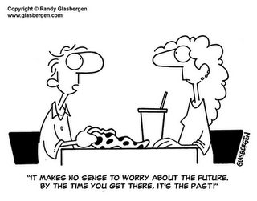
There are a number of ways of expressing the future, but we will deal here with the most important ones: WILL and GOING TO.

Slide 6
To use Will we follow the scheme below:
AFF: Will + verb in infinitive
NEG: Will + not + verb in infinitive / Won't + verb in infinitive
INT: Will + subject + verb in infinitive...?
I will study medicine when I finish high school.
I won't (will+not) waste my time.
Will you be my first patient?

Slide 7
To use GOING TO we follow the scheme below:
AFF: am/is/are + going to + verb in infinitive
NEG: am/is/are + not + going to + verb in infinitive
INT: am/is/are + subject + going to + verb in infinitive...?
She's going to study for her exam.
She isn't (is+not) going to play computer games.
Is she going to get good marks?

Slide 8
WILL or GOING TO are used to express a prediction.
Both will and going to can express the idea of a general prediction in the future.
The year 2222 will be a very interesting year.
The year 2222 is going to be a very interesting year.

Slide 9
Referencias
Redston, Ch. y Cunningham, G. (2010)
Face2face.Elementary student’s book.
Cambridge

