Slide 1
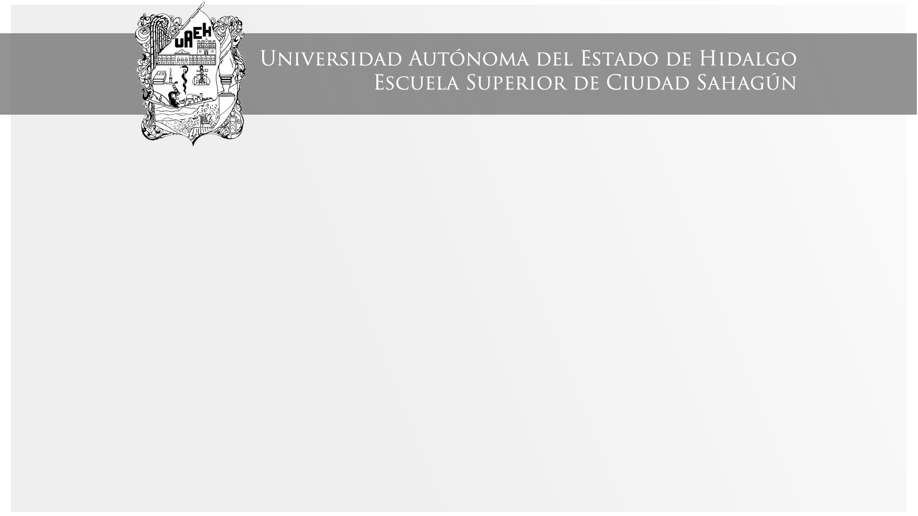
TEMA
Área Académica: Licenciatura en Contaduría
Profesor(a): María del Socorro Piedra Mayorga
Periodo: Julio – Diciembre 2015

Slide 2

MODALS
A modal is a type of auxiliary (helping) verb that is used to express: ability, possibility, permission or obligation.
Abstract
Un modal es un tipo de verbo auxiliar que es usado para expresar: posibilidad, permiso u obligación
Keywords: modal, auxiliary, ability, possibility, permission, obligation

Slide 3
M u s t
Must is a modal which means possibility or deduction
E. g.
Theodore hasn´t arrived yet and he has to send this message. It is not common he arrived too late.
He must be sick. He never misses work.

Slide 4
Examples
Paty is very tired. She must work very hard.
Jack must be home. I heard a noise coming from his room.
They are very worried. They must have a problema.

Slide 5
Exercises
To practice this, go to this page

Slide 6
Referencias
(License, 2015)
(Dynamics, 2015)
(MckCarthy, 2013)

