Slide 1
U_2_First_Conditional
Área Académica: Licenciatura en Contaduría
Profesor(a): María del Socorro Piedra Mayorga
Periodo: Julio – Diciembre 2016

Slide 2
First Conditional
Possible or likely things in the future
If + + present simple, will + infinitive
If she studies, she'll pass her exams.

Slide 3
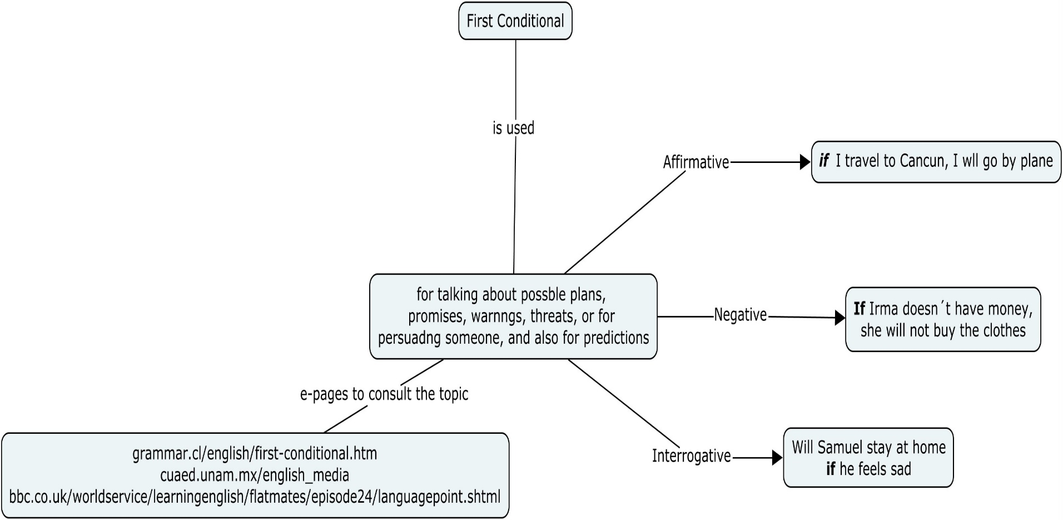
First Conditional

