Slide 1
PRESENT SIMPLE FREQUENCY ADVERBS
Área Académica: CONTADURÍA
Profesor(a): MA. E. GUADALUPE ISLAS LÓPEZ
Periodo: ENERO-JUNIO 2017

Slide 2
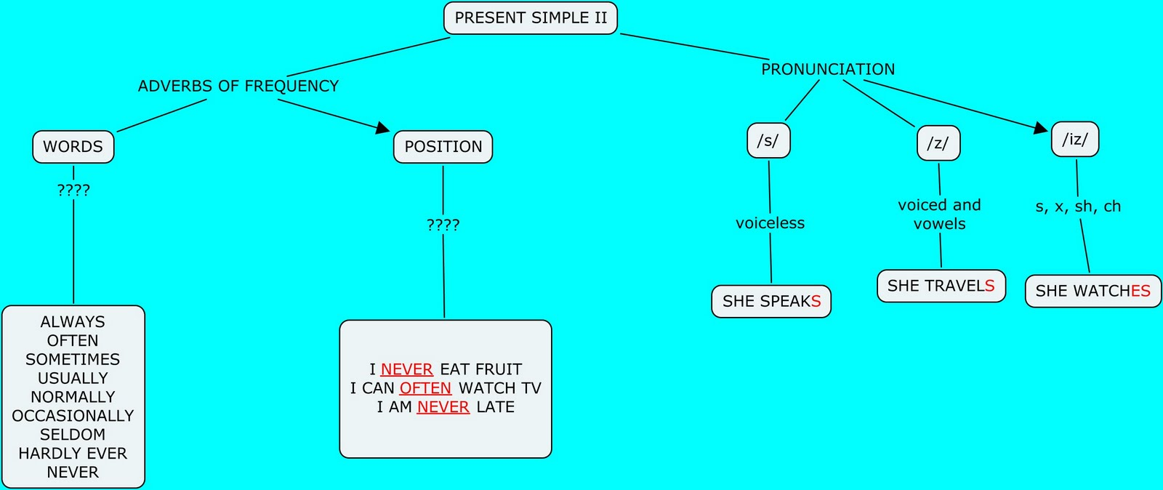
https://www.google.com.mx/search?q=MAPA+conceptual+de+present+SIMPLE&espv=2&biw=1821&bih=857&tbm=isch&tbo=u&source=univ&sa=X&ei=xqBsVcfbFdW4ogSDjoGYCA&ved=0CCYQ7Ak&dpr=0.75#imgdii=eJ_egiLCcR70wM%3A%3BeJ_egiLCcR70wM%3A%3BzWT6FaF9MESnSM%3A&imgrc=eJ_egiLCcR70wM%253A%3BavAEWH1Ml52FeM%3Bhttp%253A%252F%252Fcmapspublic.ihmc.us%252Frid%253D1LQ2WWQMN-1DQR62C-1XPD%252Fmapa%252520conceptual%252520Rosa%252520Segura%252520alvarado.cmap%253Frid%253D1LQ2WWQMN-1DQR62C-1XPD%2526partName%253Dhtmljpeg%3Bhttp%253A%252F%252Fcmapspublic.ihmc.us%252Frid%253D1LQ2WWQMN-1DQR62C-1XPD%252Fmapa%252520conceptual%252520Rosa%252520Segura%252520alvarado.cmap%3B1485%3B965

